Slide 1
CARDIAC INVOLVEMENT IN GRANULOMATOUS DISEASES
Dr. SAI SHARAN J
SENIOR RESIDENT
DEPARTMENT OF CARDIOLOGY
GMC KOZHIKODE

Slide 2
References
Braunwald’s Heart Disease: A Textbook for Cardiovascular medicine
Hurst’s: The Heart
Lehtonen J, Uusitalo V, Pöyhönen P, Mäyränpää MI, Kupari M. Cardiac sarcoidosis: phenotypes, diagnosis, treatment, and prognosis. European Heart Journal. 2023 May 1;44(17):1495-510
Kumar S, Narasimhan C. Diagnosis and management of Granulomatous Myocarditis. Indian Pacing and Electrophysiology Journal. 2022 Jul;22(4):179.
Narasimhan C, Subramanian M. Management of Ventricular Arrhythmias in Immune-Mediated Myocarditis. Clinical Electrophysiology. 2020 Oct 1;6(10):1235-7.
Roukoz H, Shah M, Masilamani LJ, Thachil A, Jayakumar PK, Benditt DG, Narasimhan C. fQRS as a marker of granulomatous disease in patients presenting with ventricular tachycardia and normal left ventricular ejection fraction. indian heart journal. 2015 May 1;67(3):222-6.
Willy K, Dechering DG, Reinke F, Bögeholz N, Frommeyer G, Eckardt L. The ECG in sarcoidosis–a marker of cardiac involvement? Current evidence and clinical implications. Journal of Cardiology. 2021 Feb 1;77(2):154-9.
Schatka I, Bengel FM. Advanced imaging of cardiac sarcoidosis. Journal of Nuclear Medicine. 2014 Jan 1;55(1):99-106.
Thachil A, Christopher J, Sastry BK, Reddy KN, Tourani VK, Hassan A, Raju BS, Narasimhan C. Monomorphic ventricular tachycardia and mediastinal adenopathy due to granulomatous infiltration in patients with preserved ventricular function. Journal of the American College of Cardiology. 2011 Jun 28;58(1):48-55.

Slide 3
References
Birnie DH, Nery PB, Ha AC, Beanlands RS. Cardiac sarcoidosis. Journal of the American College of Cardiology. 2016 Jul 26;68(4):411-21.
Clivillé DB, Moliner-Abós C, Gallego IM, Camprecios M. Myocarditis with concomitant tuberculosis infection presenting with solitary ventricular tachycardia: a case report. European Heart Journal-Case Reports. 2023 Oct;7(10):ytad432.
López‐López JP, Posada‐Martínez EL, Saldarriaga C, Wyss F, Ponte‐Negretti CI, Alexander B, Miranda‐Arboleda AF, Martínez‐Sellés M, Baranchuk A, Neglected Tropical Diseases, Other Infectious Diseases Affecting the Heart (the NET‐Heart Project). Tuberculosis and the heart. Journal of the American Heart Association. 2021 Apr 6;10(7):e019435.
Marcu DT, Adam CA, Mitu F, Cumpat C, Aursulesei Onofrei V, Zabara ML, Burlacu A, Crisan Dabija R. Cardiovascular Involvement in Tuberculosis: From Pathophysiology to Diagnosis and Complications—A Narrative Review. Diagnostics. 2023 Jan 25;13(3):432.
Bansal R, Parakh N, Naik N, Jagia P, Gulati G, Juneja R, Ray R, Mohan A, Seth S. Acute arrhythmia or ventricular dysfunction-when is it sarcoid? Indian perspective. Journal of Primary Care Specialties. 2015 Sep 1;1(3):252-61.
Aljizeeri A, Al-Mallah MH. TheRoleof NoninvasiveCardiacImagingin theManagementof Diseases of theCardiovascularSystem. Radiology-Nuclear Medicine Diagnostic Imaging: A Correlative Approach. 2023 Mar 6:257.

Slide 4
Outline
Sarcoidosis
  Introduction
  Etiopathogenesis
  Diagnosis
  Treatment
  Newer aspects
TB and the heart
  TB myocarditis
Diagnostic approach to patient with granulomatous myocarditis
Differential diagnosis

Slide 5
Introduction: Sarcoidosis
Multisystem granulomatous disease of unknown aetiology
Caused by an immunological response to an unidentified antigenic trigger in genetically susceptible persons
Age: 25-60 years of age
Rare in people with age <15 or > 70 years
Prevalence of CS in patients with systemic sarcoidosis- 3.7-54.9%
Prevalence of isolated CS- 5%

Slide 6
Cardiac Sarcoidosis: Overview
Presents in tandem or can be even isolated sign of sarcoidosis
Granulomas frequently infiltrate the myocardium
Clinical spectrum: Silent disease to SCD
Predominant manifestations: conduction abnormalities, ventricular arrhythmias, and heart failure
No criteria is validated or universally adopted for diagnosis of CS
No control trial data exists on proper treatment aspects

Slide 7
Risk factors
Genetic susceptibility-as noted by familial clustering of cases
HLA-DQB and TNFA2 allele
Environmental factors- infectious agents (Propionibacterium acnes), metals, combustive materials
“Early onset sarcoidosis”- heterogenous mutations in CARD15 gene
Occupational exposure to silica dust
Previous tuberculosis- ESAT-6
Obesity
Negative association with smoking

Slide 8
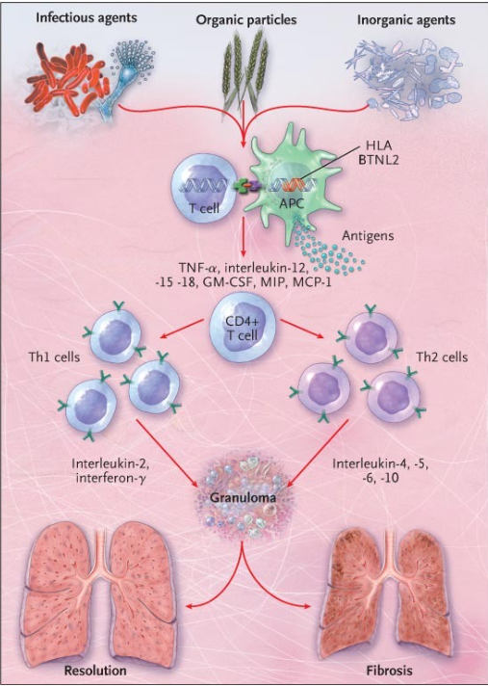
Pathogenesis
Ueberham L, Hagendorff A, Klingel K, Paetsch I, Jahnke C, Kluge T, Ebbinghaus H, Hindricks G, Laufs U, Dinov B. Pathophysiological Gaps, Diagnostic Challenges, and Uncertainties in Cardiac Sarcoidosis. Journal of the American Heart Association. 2023 Mar 21;12(6):e027971.

Slide 9
Phenotypes
Phenotypes of cardiac sarcoidosis
CS hidden until autopsy
CS with dominant extracardiac sarcoidosis
Clinically manifest CS

Slide 10
Clinically manifest CS
50% of the patients give a history of sarcoidosis, and are found to have multi-organ disease
Prevalence of isolated CS varies from 3-43%, the most approximate being 20-25%
De novo or clinically isolated CS, implies more serious disease than CS appearing on top of extracardiac disease

Slide 11
Manifestations of CS
High grade AV block
VT- re-entry circuits in inflamed and scarred myocardium
Heart failure- widespread infiltration of granulomas
Mitral regurgitation- LV or mitral annular dilatation
Angina like chest pain
Effusive and constrictive pericarditis
Recurring pericardial effusion

Slide 12
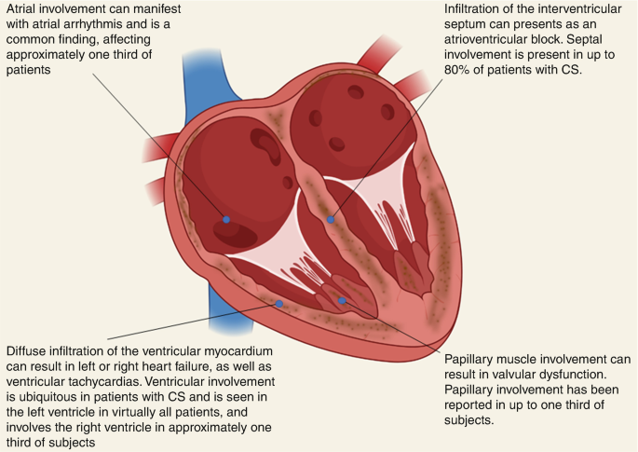

Slide 13
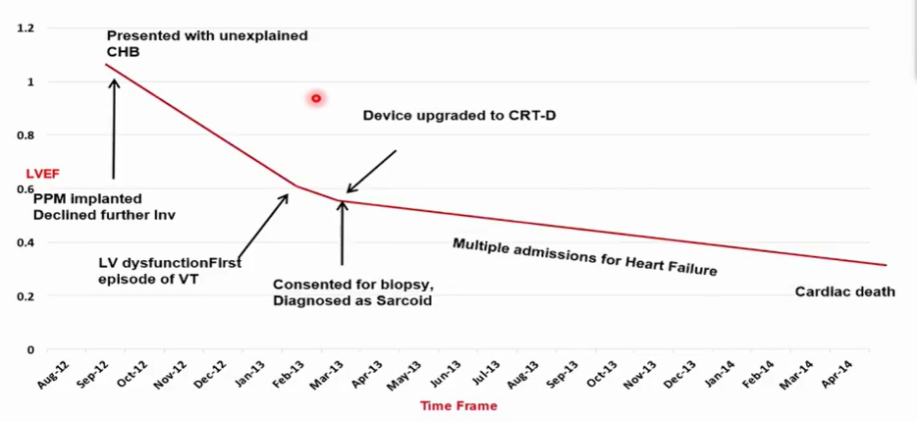

Slide 14
Electrocardiography
Usually abnormal in all patients with clinically manifest disease
Abnormal in 3-8% of patients with clinically silent CS
Various degrees of conduction block- isolated BBB and fascicular block
QRS complex fragmentation
ST-T wave changes
Pathological Q waves- pseudo-infarct pattern
Rarely, epsilon waves

Slide 15
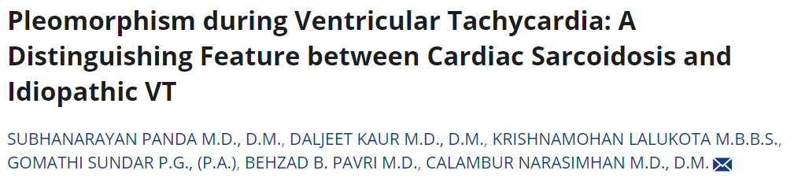
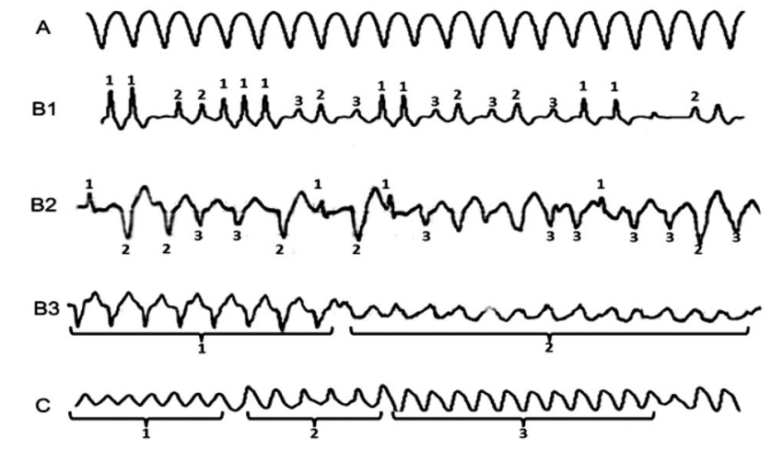

Slide 16
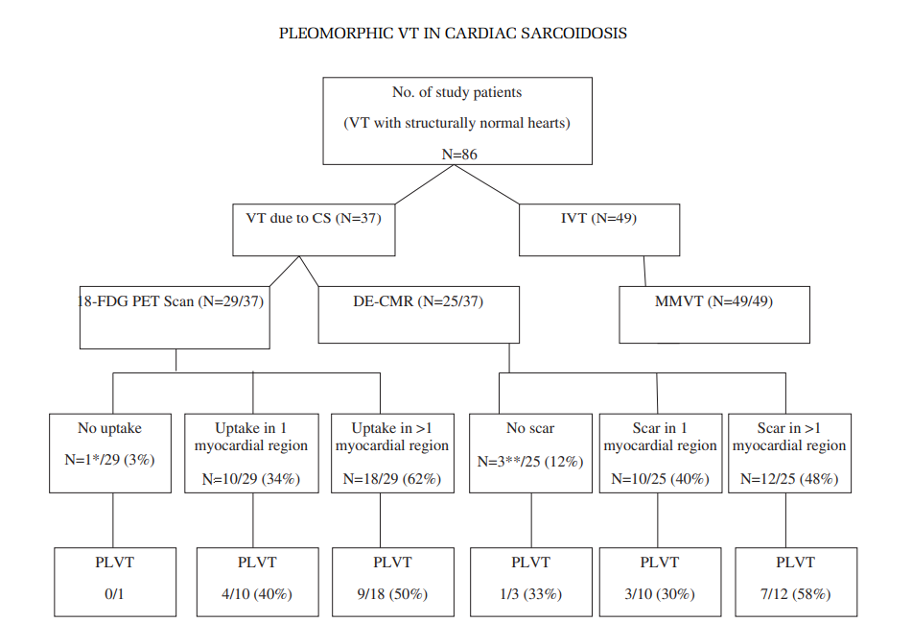
Panda S, Kaur D, Lalukota K, Sundar G, Pavri BB, Narasimhan C. Pleomorphism during ventricular tachycardia: a distinguishing feature between cardiac sarcoidosis and idiopathic VT. Pacing and Clinical Electrophysiology. 2015 Jun;38(6):694-9.

Slide 17
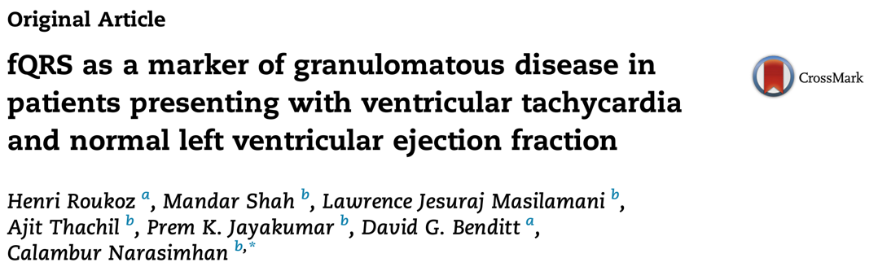
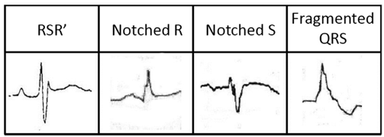
QRS <120ms, fQRS defined as presence of an additional R wave, notching in the nadir of S wave or presence of >1 R in at least 2 contiguous leads
QRS >120ms in presence of BBB, >2 R or >2 notches in the nadir of R wave or S wave in two contiguous leads
81% of the GVT and 50% in control group
Corresponds to affected segment on imaging

Slide 18
Echocardiography
LV dysfunction (EF <50%)
LV wall thickening or thinning
Local akinesia or dyskinesia- Basal septum thinning
Regional wall motion abnormalities- non-coronary distribution
LV aneurysm
Reduced global LV longitudinal strain-94% sensitive (cutoff of -17%)
Pericardial effusion

Slide 19
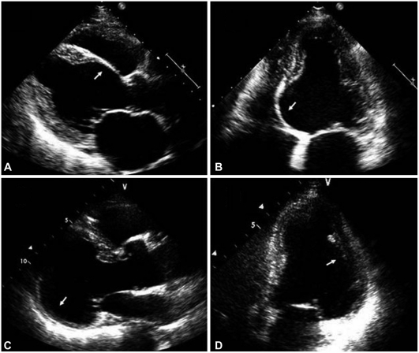
2D echocardiography: Shows thinning and akinetic basal septum with aneurysmal dilatation of inferolateral wall

Slide 20
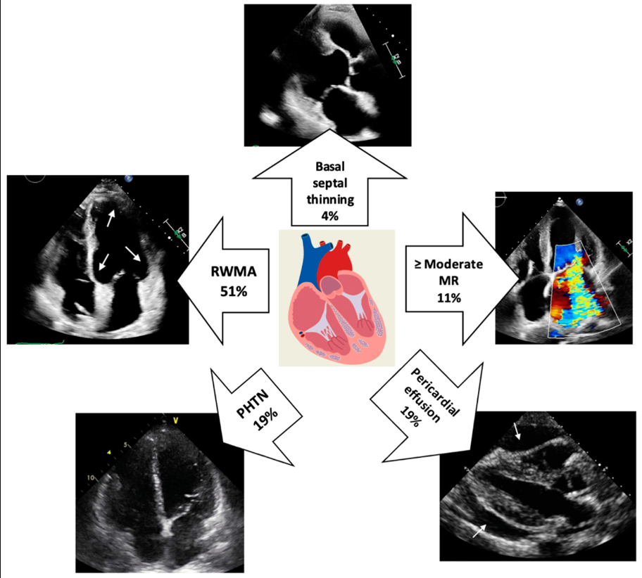

Slide 21
Biomarkers
Angiotensin converting enzyme
  Elevated in 60% of patients with sarcoidosis
  Lack sensitivity and specificity
Novel biomarkers- Neopterin, soluble IL-2 receptor, circulating lysozyme levels

Slide 22
Radionuclide scan
⁶⁸Ga-DOTANOC: attaches to special somatostatin receptors (SSTR) on all inflammatory mediators
SSTR2A- normal myocardial cells lacks them
²⁰¹Tl, ^{99m}Tc-sestamibi and ⁶⁷Ga scintigraphy
MPI shows patterns of reverse distribution, in which perfusion defects at rest decrease under stress conditions
CMR and PET/CT have replaced these imaging techniques

Slide 23
CMR
High inherent tissue contrast- good for picking up oedema
Good temporal resolution- provides functional assessment
Restrictive LV pattern
  Non-dilated LV, preserved LV function, restrictive filling pattern and atrial enlargement
Myocardial granulomas- Intramural/ Spotty/ Involves basal septum and free wall

Slide 24
CMR(cont.)
Myocardial oedema, necrosis, and scarring
Septal thinning, local dyskinesia, and ventricular aneurysm
Inflammation- gadolinium enhancement 3-5 min after contrast administration
Delayed or Late gadolinium enhancement (LGE)- Key CMR modality in CS
Mech of LGE: Delayed contrast wash out related to necrosis and oedema in acute setting and fibrosis in chronic setting

Slide 25
CMR(cont.)
LGE involves basal LV segments and RV side of the septum
Patchy, non-ischemic, mid-myocardial and epicardial distribution
‘Hook sign’ or ‘Hug sign’: LGE of the septum continuing into the free wall of ventricles
Extent of LGE: percentage of LV mass or number of involved segments

Slide 26
CMR(cont.)
Presence of LGE: independent risk factor for VA and SCD
Very high NPPV for adverse outcomes
Limitation of LGE: Does not discriminate between areas of active inflammation versus fibrosis
Large extent LGE (>20%):
  Higher risk of cardiac mortality
  Hospitalisation for HF
  Life threatening arrhythmias
  Less response to steroids

Slide 27
CMR(cont.)
Newer techniques-
  T1 Mapping: quantifies fibrosis
  T2 Mapping and ECV Mapping: quantifies oedema
  Strain Mapping: early detection of diastolic dysfunction

Slide 28
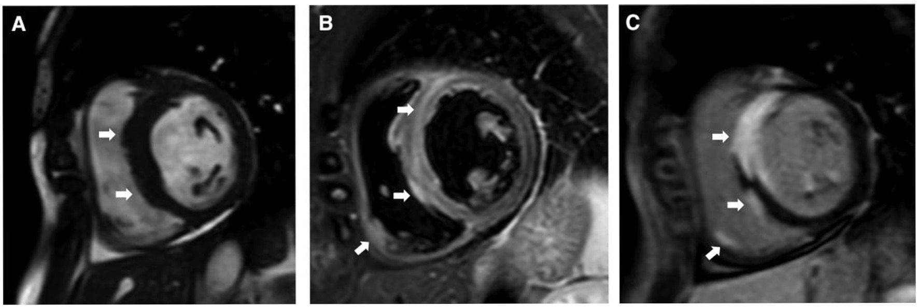
Patient with III AV block. Septal thickening, oedema of septum and right ventricle with late gadolinium enhancement of transmural septum and local RV free wall
Lehtonen J, Uusitalo V, Pöyhönen P, Mäyränpää MI, Kupari M. Cardiac sarcoidosis: phenotypes, diagnosis, treatment, and prognosis. European Heart Journal. 2023 May 1;44(17):1495-510

Slide 29
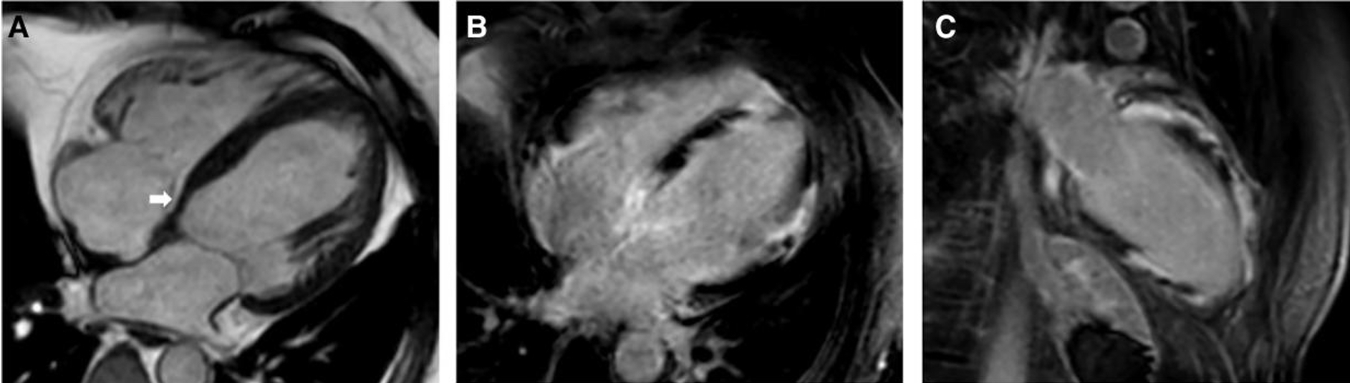
Patient with III AV block with depressed LV function. CMR shows thinning of septum with patchy LGE of LV free all
Lehtonen J, Uusitalo V, Pöyhönen P, Mäyränpää MI, Kupari M. Cardiac sarcoidosis: phenotypes, diagnosis, treatment, and prognosis. European Heart Journal. 2023 May 1;44(17):1495-510

Slide 30
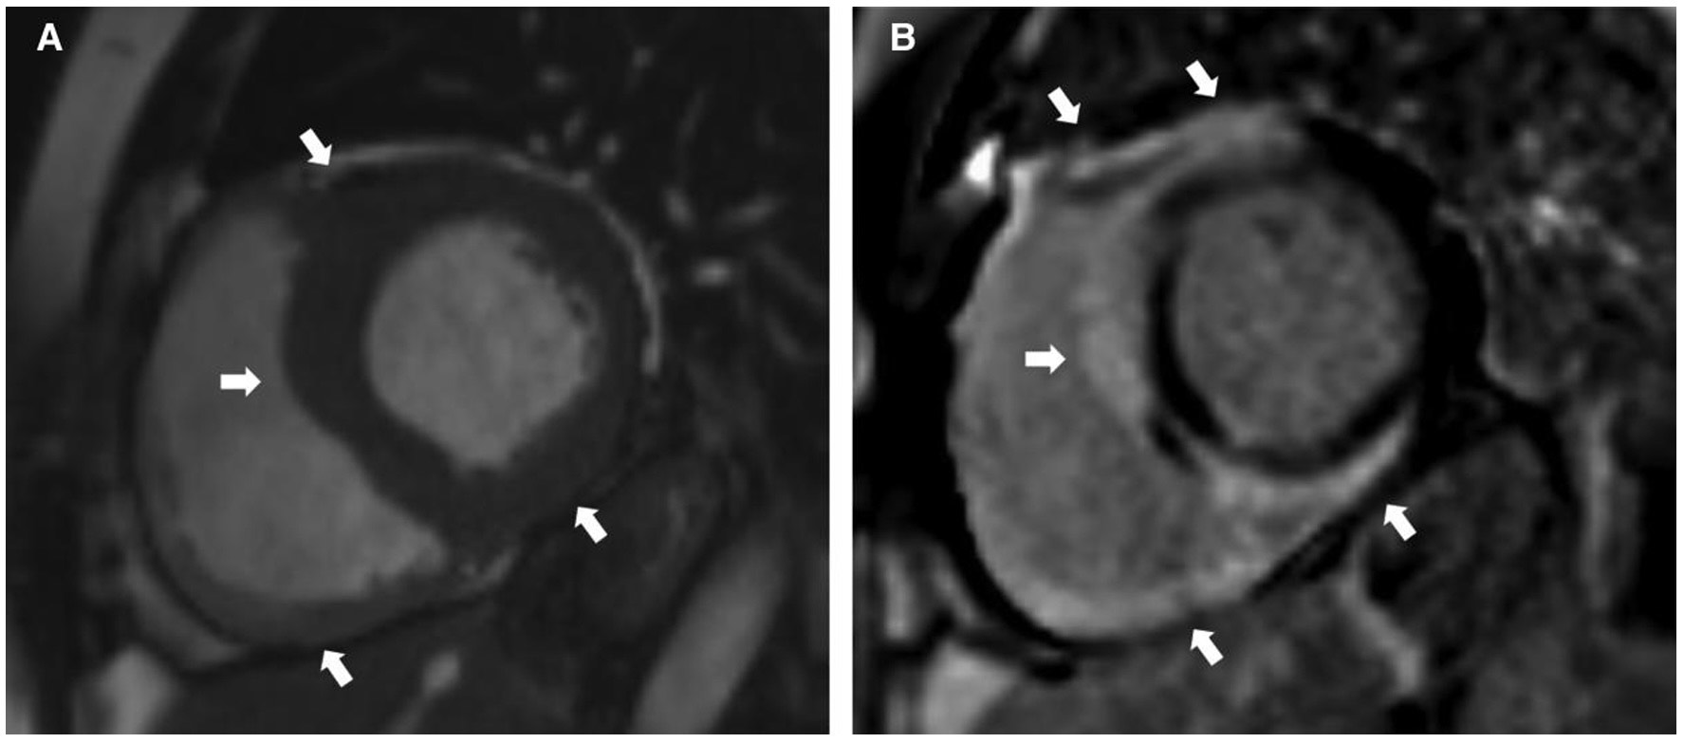
Patient with RBBB, monomorphic VT. CMR shows thickening of the LV free wall, septum, inferior RV. Characteristic “Hook sign” pattern of cardiac sarcoidosis
Lehtonen J, Uusitalo V, Pöyhönen P, Mäyränpää MI, Kupari M. Cardiac sarcoidosis: phenotypes, diagnosis, treatment, and prognosis. European Heart Journal. 2023 May 1;44(17):1495-510

Slide 31
FDG-PET
Principle- active inflammatory cells in sarcoid granulomas avidly take up glucose and its analogs (Metabolic trapping)
Whole body PET-to detect extra-cardiac sarcoidosis
Physiologic cardiac glucose metabolism is switched off by:
  Low carbohydrate/high fat diet
  Prolonged fasting
  IV unfractionated heparin
Parallel scanning with perfusion tracers to assess LV scarring
PET is combined with CT for co-localisation and attenuation correction

Slide 32
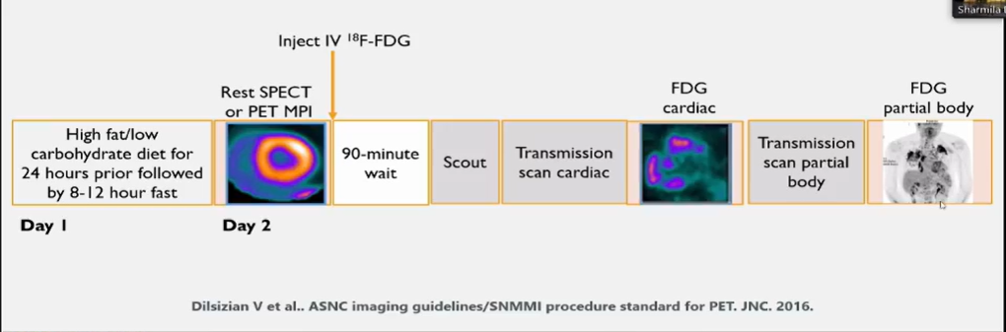

Slide 33
FDG-PET(cont.)
One or more spots of increased 18F-FDG uptake on suppressed or diffuse myocardial uptake
‘Mismatch pattern’-hot spot of 18F-FDG overlapping a perfusion defect
Perfusion defects- LV scarring or impairment of microcirculation
Mismatch pattern and RV uptake are key predictors of cardiac events
Atrial uptake portends atrial tachyarrhythmias
Standardised uptake values (SUV): degree of myocardial inflammation

Slide 34
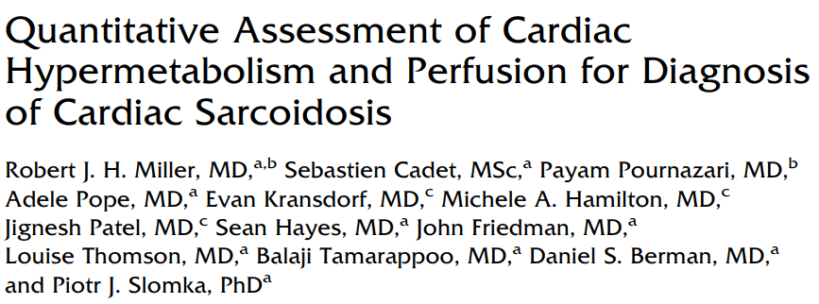
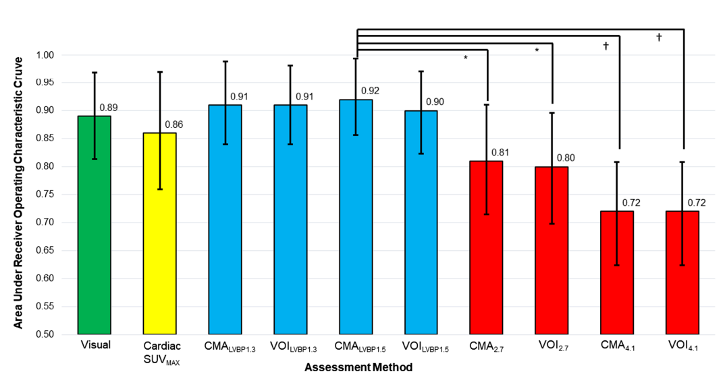

Slide 35
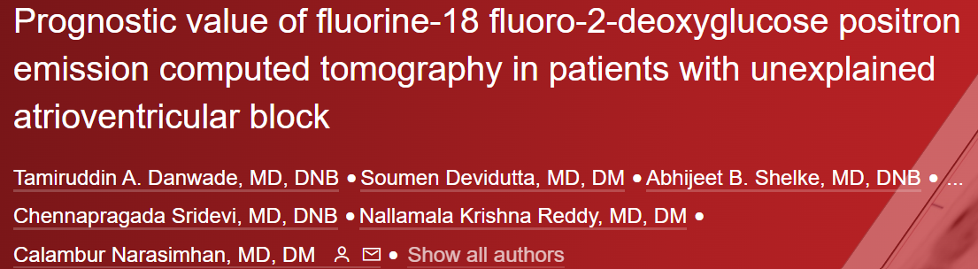
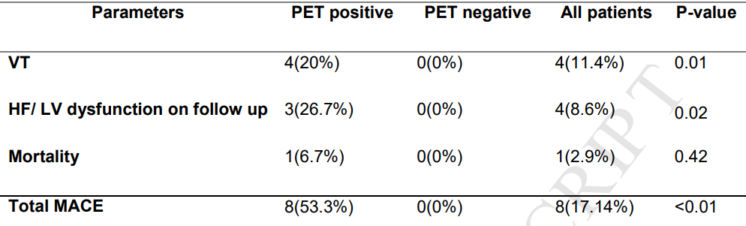

Slide 36
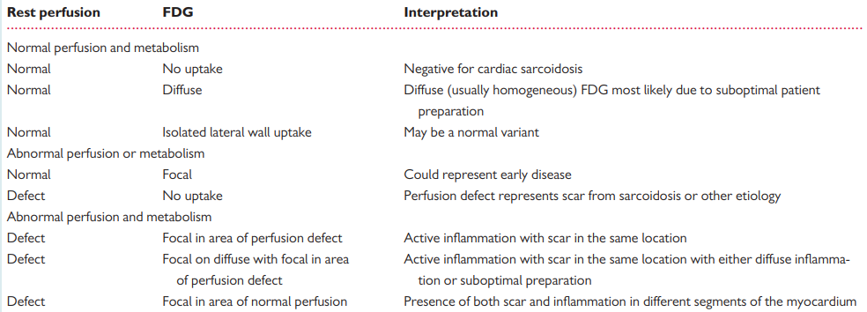
Blankstein R, Osborne M, Naya M, Waller A, Kim CK, Murthy VL et al. Cardiac positron emission tomography enhances prognostic assessments of patients with suspected cardiac sarcoidosis. J Am Coll Cardiol 2014;63:329–36.

Slide 37
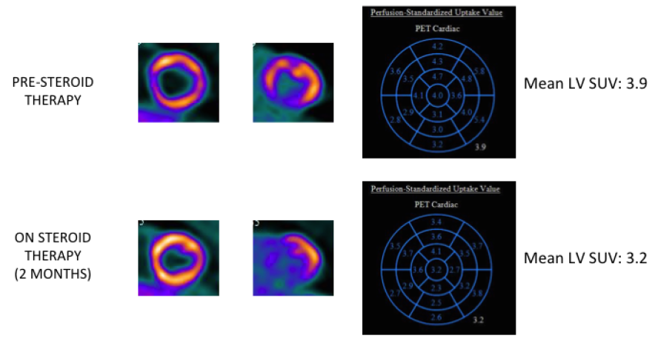

Slide 38
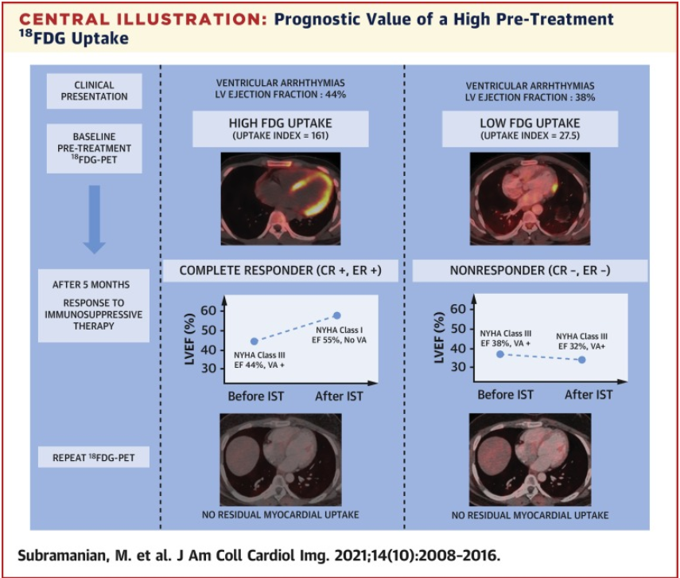
Complete responders had higher baseline myocardial and mediastinal FDG uptake compared with partial responders and non-responders.

Slide 39
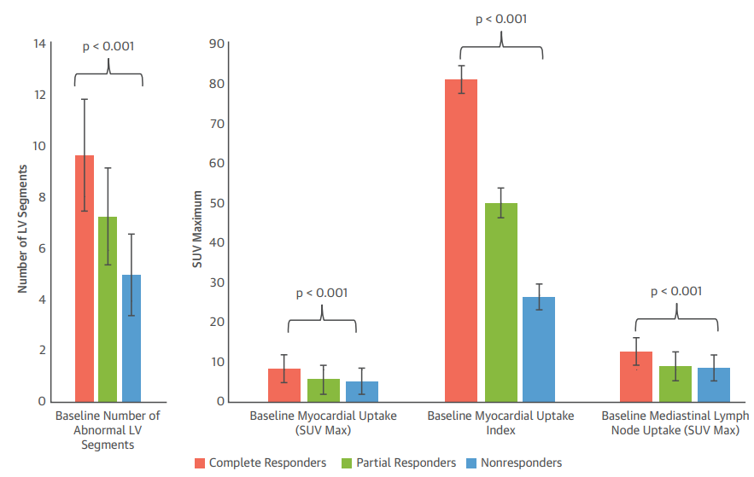
Subramanian M, Swapna N, Ali AZ, Saggu DK, Yalagudri S, Kishore J, Swamy LN, Narasimhan C. Pre-treatment myocardial 18FDG uptake predicts response to immunosuppression in patients with cardiac sarcoidosis. Cardiovascular Imaging. 2021 Oct 1;14(10):2008-16.

Slide 40
PET vs CMR
Advantages of CMR over PET
  Lower number of non-diagnostic scans
  No patient exposure to ionising radiation
  No need of specialized patient preparation
  Identifies alterative cause of cardiomyopathy
  Adjunct information about biventricular function, wall motion abnormality, wall thickness

Slide 41
PET vs CMR(cont.)
Advantages of PET over CMR
  No risk of gadolinium induced nephropathy
  Early stages of the disease
  Evaluate extra-cardiac sarcoidosis
  Can be done in patient with pacemakers, ICD, CKD
  Quantify the risk (SUV)
  Treatment monitoring

Slide 42
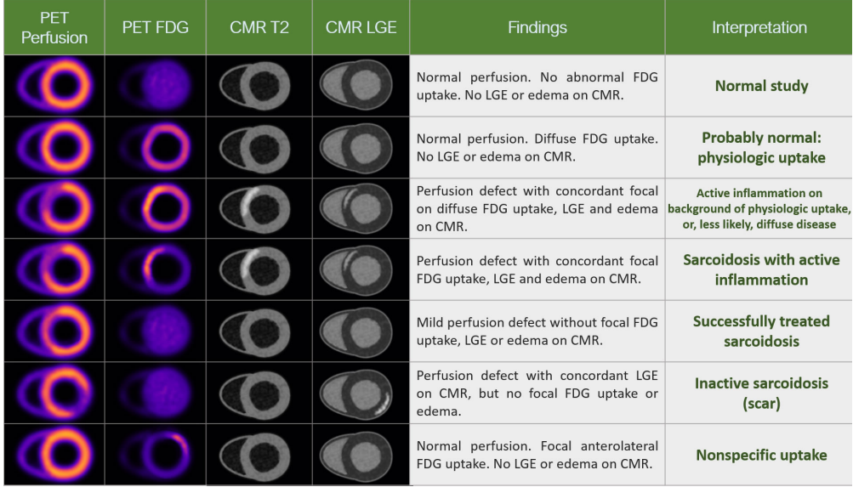
Is one modality enough: Hybridization of PET/CMR
Elwazir MY, Bois JP, Abou Ezzeddine OF, Chareonthaitawee P. Imaging and quantification of cardiac sarcoidosis. InSeminars in Nuclear Medicine 2020 Jul 1 (Vol. 50, No. 4, pp. 283-294). WB Saunders

Slide 43
Biopsy
HRS guidelines- recommend extracardiac over EMB
Non-targeted RV biopsy- sensitivity is only around 20%
Cardiac imaging and intracardiac voltage mapping improves EMB’s sensitivity
Higher yield if LVEF is low, mismatch pattern in PET or signs of RV involvement
LV biopsy from VATS
HPE: Non-necrotic granulomas, isolated giant cells with or without surrounding lymphocytic/granulocytic infiltration combined with myocardial fibrosis.
DDx: ARVC, amyloidosis, giant cell myocarditis, end stage DCMP

Slide 44
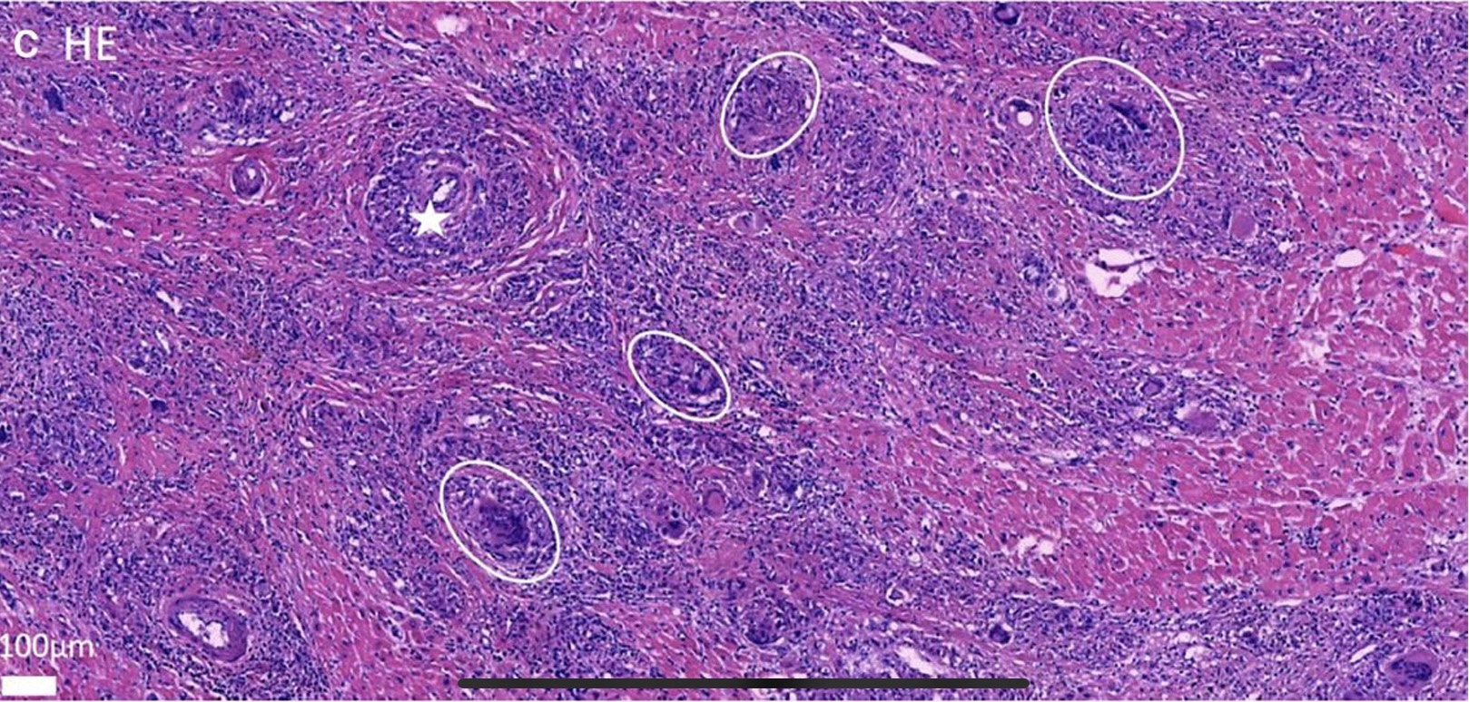
Histopathology of cardiac sarcoidosis: The HPE picture depicts the non-caseating granulomas with vascular wall granulomas

Slide 45
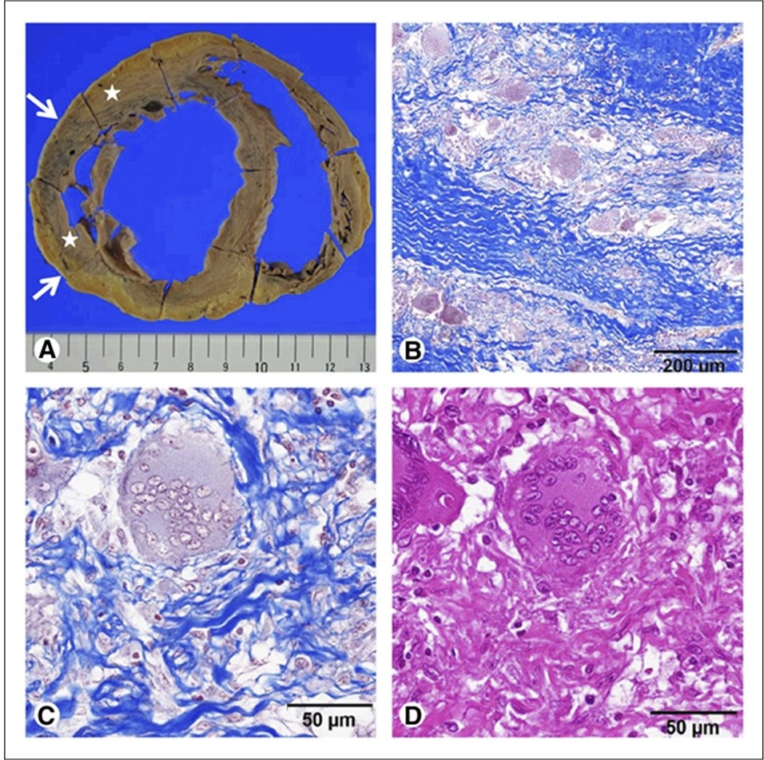
Histopathology of cardiac sarcoidosis: Sarcoid granuloma with interstitial fibrosis stained by Masson trichome stain

Slide 46
 | Sensitivity | Specificity | Radiation | Advantages | Limitations
MPI | 35-60% | - | 12-18 mSv | Pattern distinct from ischemia | Reverse distribution not specific for CS
67 Gallium Scintigraphy | 0-36% | 80-100% | 9mSv | Whole body imaging May assess treatment response | Low spatial resolution Low sensitivity
18-FDG PET | 89-100% | 38-97% | 7mSv | Whole body imaging May assess treatment response | Cumbersome procedure Patient preparation
CMR | 100% | 78% | None | High spatial resolution High sensitivity | Renal failure Metallic devices

Slide 47
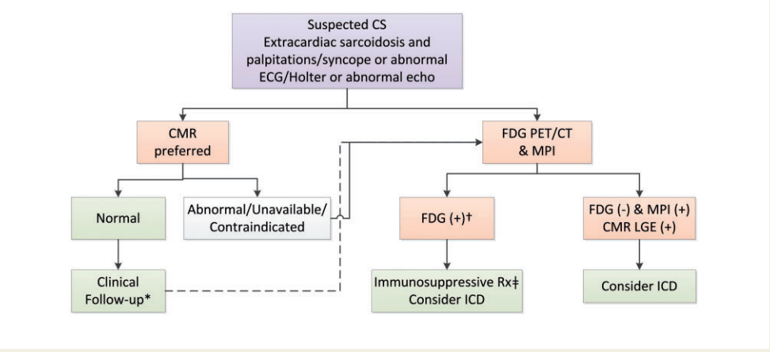
"A joint procedural position statement on imaging in cardiac sarcoidosis: from the Cardiovascular and Inflammation & Infection Committees of the European Association of Nuclear Medicine, the European Association of Cardiovascular Imaging, and the American Society of Nuclear Cardiology." European Heart Journal-Cardiovascular Imaging 18, no. 10 (2017): 1073-1089.

Slide 48
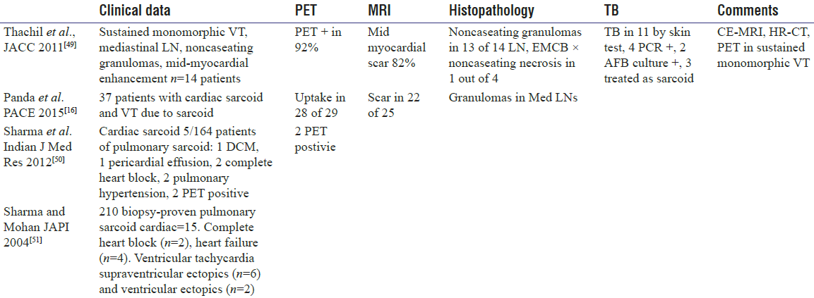
Indian Data on cardiac sarcoid

Slide 49
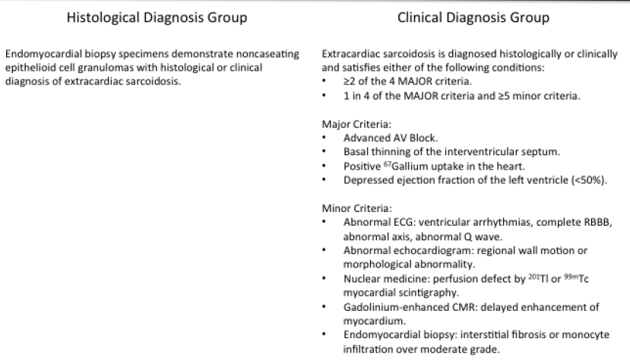
JCS 2016 guidelines

Slide 50
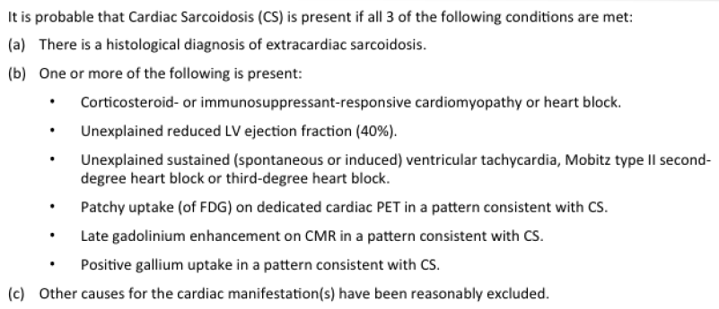
Heart Rhythm Society guidelines

Slide 51
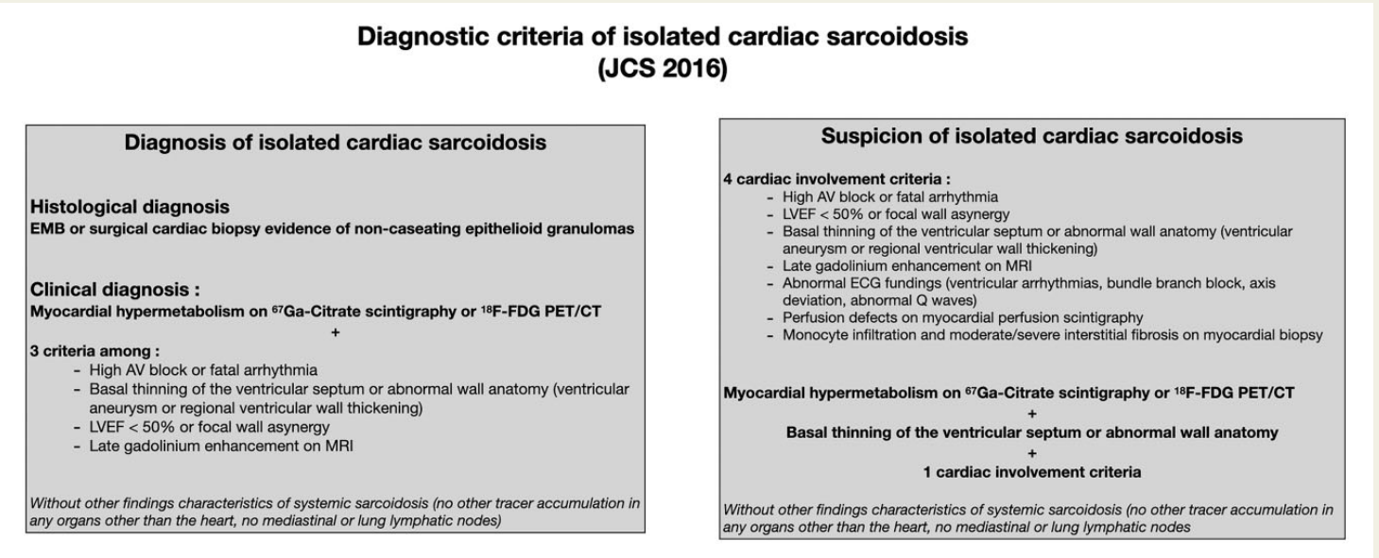
Kawai H, Sarai M, Kato Y, Naruse H, Watanabe A, Matsuyama T, Takahashi H, Motoyama S, Ishii J, Morimoto SI, Toyama H. Diagnosis of isolated cardiac sarcoidosis based on new guidelines. ESC Heart Failure. 2020 Oct;7(5):2662-71.

Slide 52
Indications to treat
Mobitz II or 3rd degree heart block and evidence of myocardial inflammation
Frequent ventricular ectopy or non-sustained VAs and evidence of myocardial inflammation
Sustained VAs and evidence of myocardial inflammation
LV dysfunction and evidence of myocardial inflammation

Slide 53
Immunosuppression
Corticosteroids- improve AV conduction in 40% of patients and may prevent deterioration of LV function
Effects on arrhythmias and mortality remain ambiguous due to poor data quality
In subclinical disease with absent LV dysfunction, the benefit of CS is unclear
Prednisolone is started at a dose of 0.5mg/kg
Rapid progressively heart failure, life threatening arrhythmias and extensive inflammation on PET: IV methylprednisolone for 2-3 days

Slide 54
Immunosuppression(cont.)
Steroids are down-titrated 5-10mg every 4 weekly, until a maintenance of 10mg/day is reached
Follow up: 3-6 months
‘Selective’ over ‘routine’ PET strategy is preferred
Second line immunosuppression: MTX, azathioprine, MMF, lenflunomide
Biologics: TNF-alpha inhibitors, Adalimumab

Slide 55
First randomised study: CHASM CS-RCT
Objective: Low dose prednisolone with MTX is non-inferior to standard dose prednisolone
All patients with clinically manifest cardiac sarcoidosis with one or more: AV block/VAs/Sinus node abnormalities/LV or RV failure are randomised into 2 groups
I. Prednisolone 0.5mg/kg/day for 6 months
II. Prednisolone 20mg OD tapered over 3 months along with MTX 15-20mg weekly for 6 months
Assess summed perfusion rest score on 6-month PET

Slide 56
Symptomatic VAs
Role of steroids on symptomatic VAs is unpredictable
Amiodarone and sotalol are started along with CS
Beta blockers can be added
Class I AA drugs avoided in structural heart disease with myocardial scarring
If medical therapy fails, catheter ablation can be tried

Slide 57
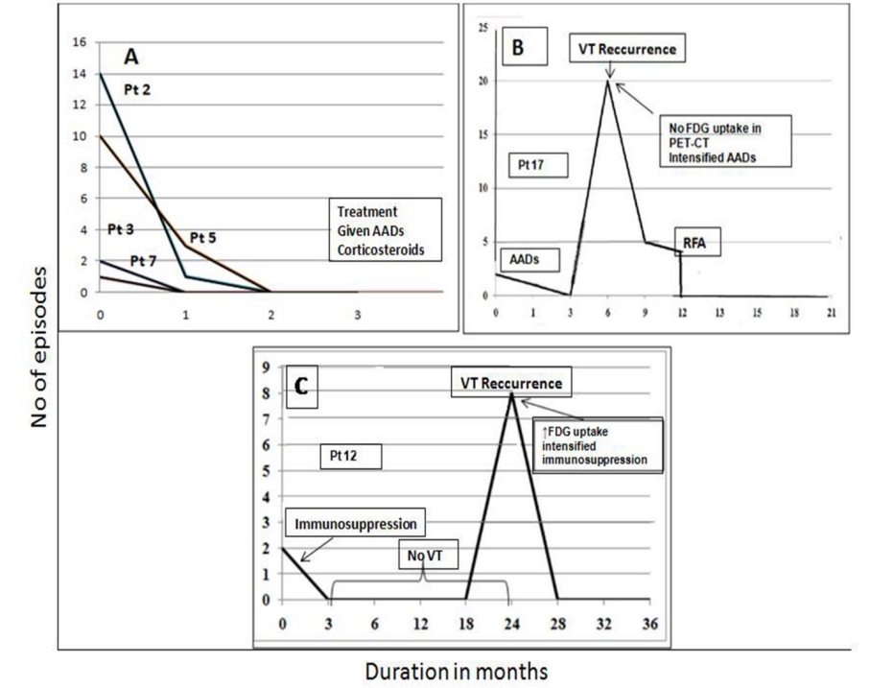
Yalagudri S, Zin Thu N, Devidutta S, Saggu D, Thachil A, Chennapragada S, Narasimhan C. Tailored approach for management of ventricular tachycardia in cardiac sarcoidosis. Journal of Cardiovascular Electrophysiology. 2017 Aug;28(8):893-902.

Slide 58
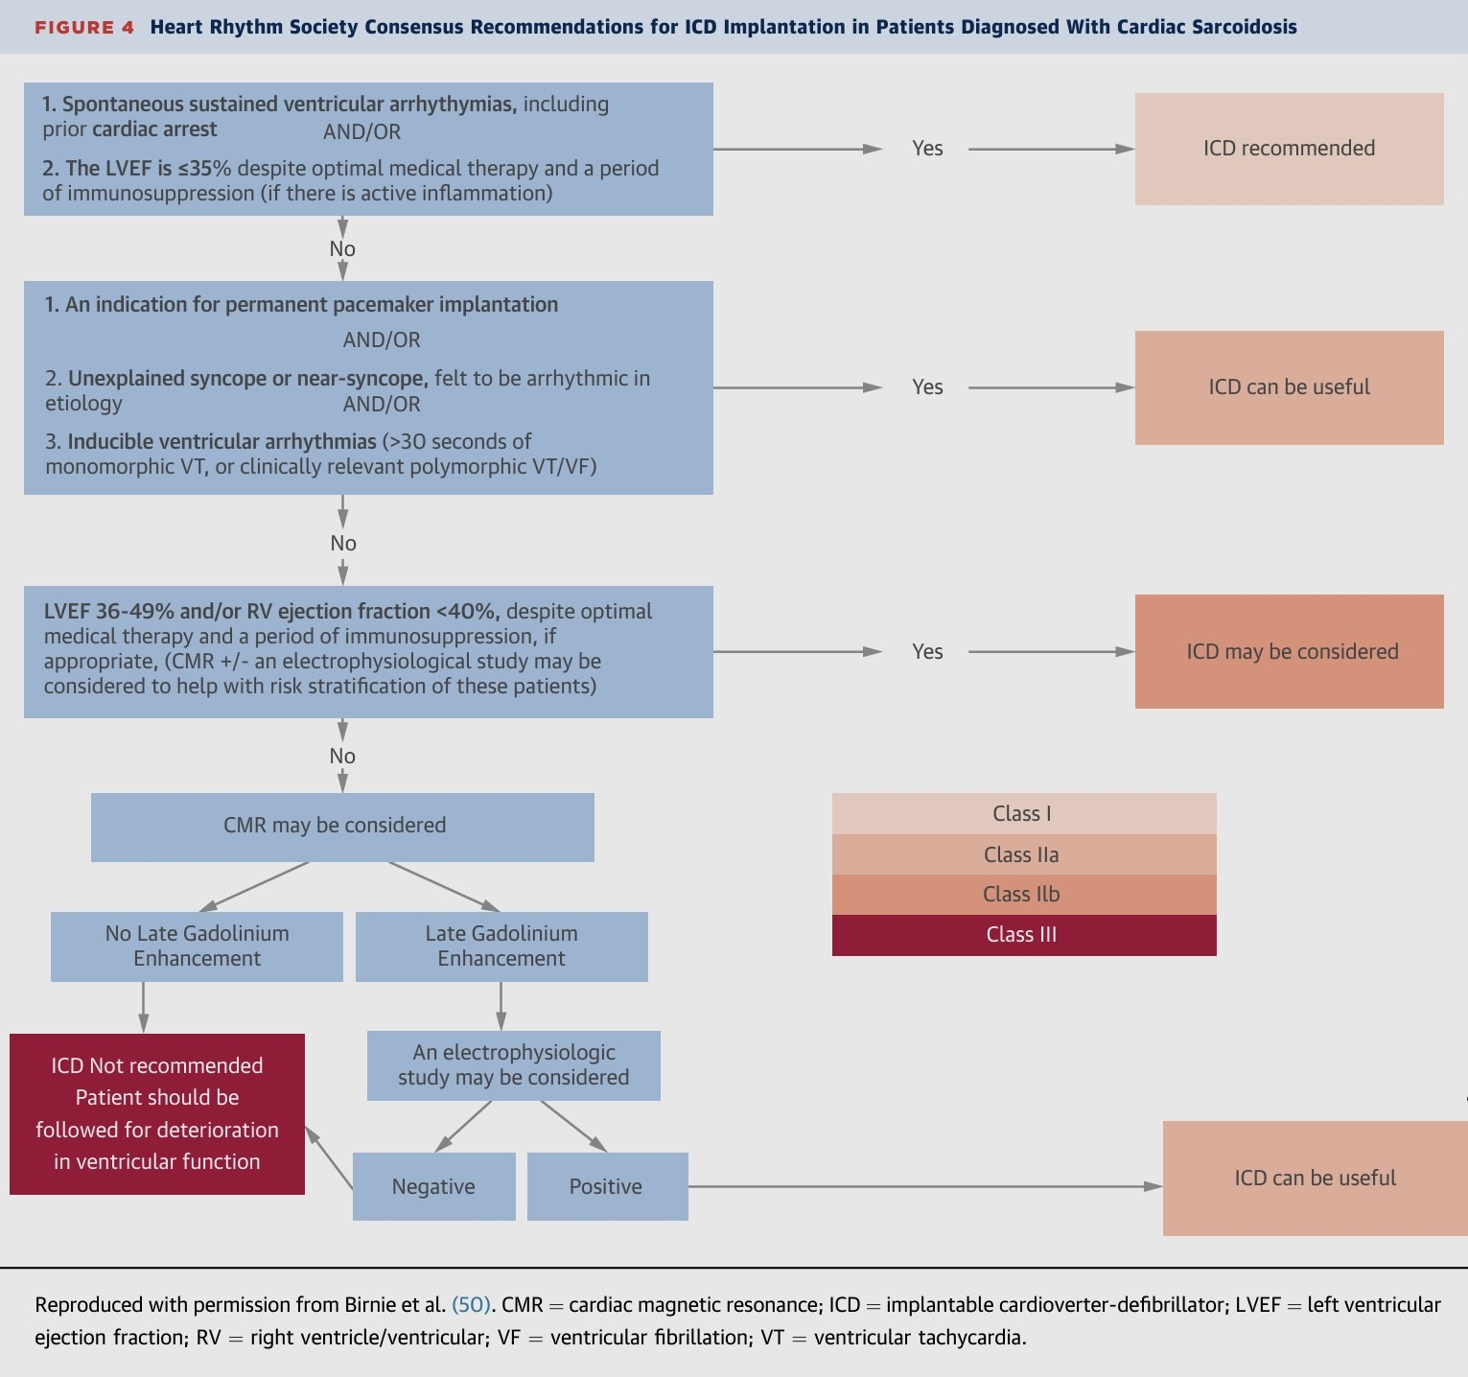

Slide 59
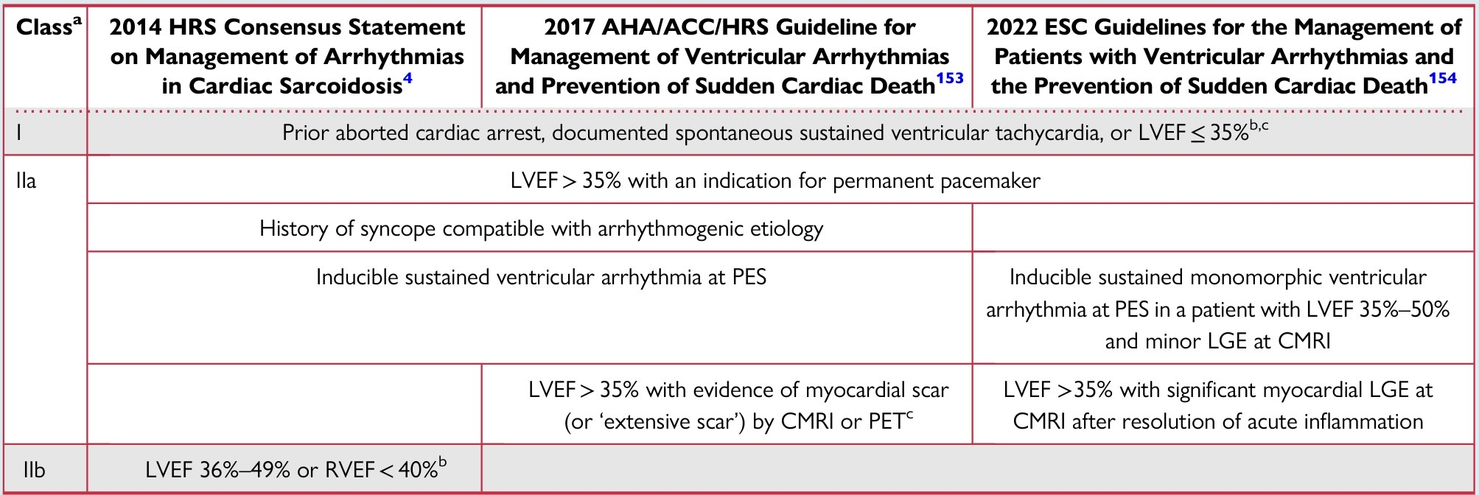
Prevention of SCD

Slide 60
TB and the heart

Slide 61
Cardiovascular involvement in TB
Pericarditis
Myocarditis
Coronary artery disease
Intracardiac tuberculoma
Aortitis

Slide 62
Tubercular myocarditis
May be associated with pericarditis
Isolated myocarditis is rare
Common in patients less than 45 years of age
Males > Females
Higher risk among immunocompromised
HIV co-infected

Slide 63
Tubercular myocarditis
Mode of spread:
  Haematological route
  Retrograde lymphatic insemination through mediastinal nodes
  Direct invasion from the pericardium
Myocardium is not frequently involved:
  Continuous movement of myocardium
  Production of lactic acid

Slide 64
Clinical features
Myocardial damage is frequently asymptomatic
Anatomic predilection for right mediastinal node involvement
Ventricular arrhythmias, sudden death, long QTc, AV blocks
Morphological forms of TB:
  Nodular myocarditis with central caseation
  Miliary forms
  Diffuse, inflammatory, giant cell forms

Slide 65
Diagnosis
Pericardial fluid analysis
ADA, IFN-gamma, PCR for TB bacillus- IS6110
IFN-gamma with cut off 50ng/ml: sensitivity of 92% and specificity of 100%
Liquid culture for tuberculosis- gold standard
Extra-cardiac foci of TB

Slide 66
CMR in TB
T1-weighted spin echo CMR: pericardial thickness and simultaneous pericardial effusion
T2-weighted STIR spin echo: pericardial layer oedema
Gadolinium enhancement of pericardial layer suggests pericarditis
Fat suppressive pre-pulse can enhance the visibility of pericardial inflammation

Slide 67
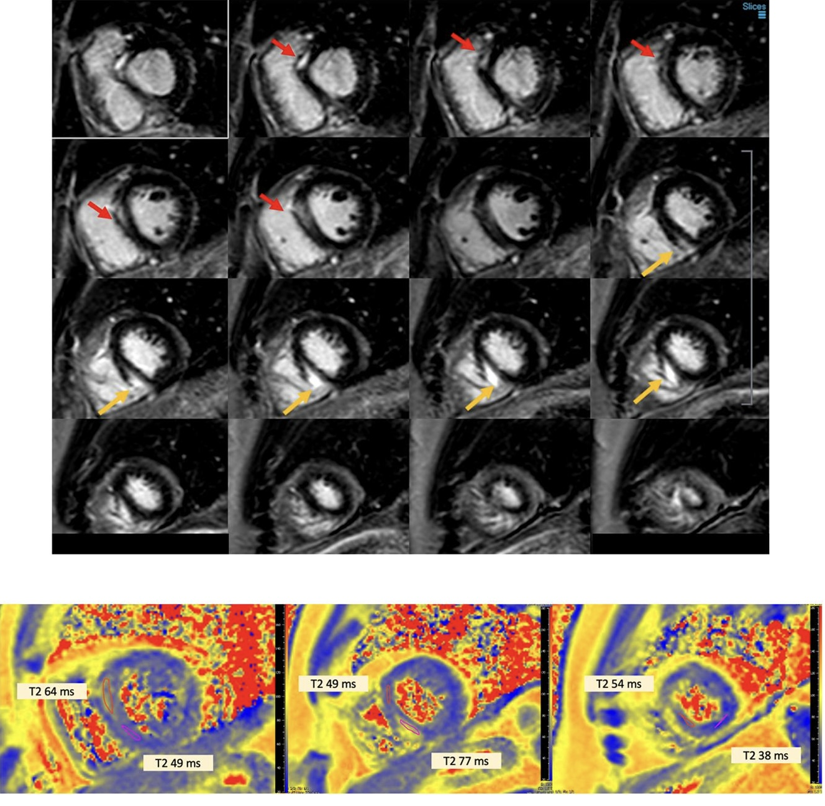
Diffuse patchy hyperenhancement of anteroseptal wall and mid inferior-septal wall
T2-mapping sequence shows elevated T2 time in anteroseptal and inferoseptal segments consistent with myocardial oedema

Slide 68
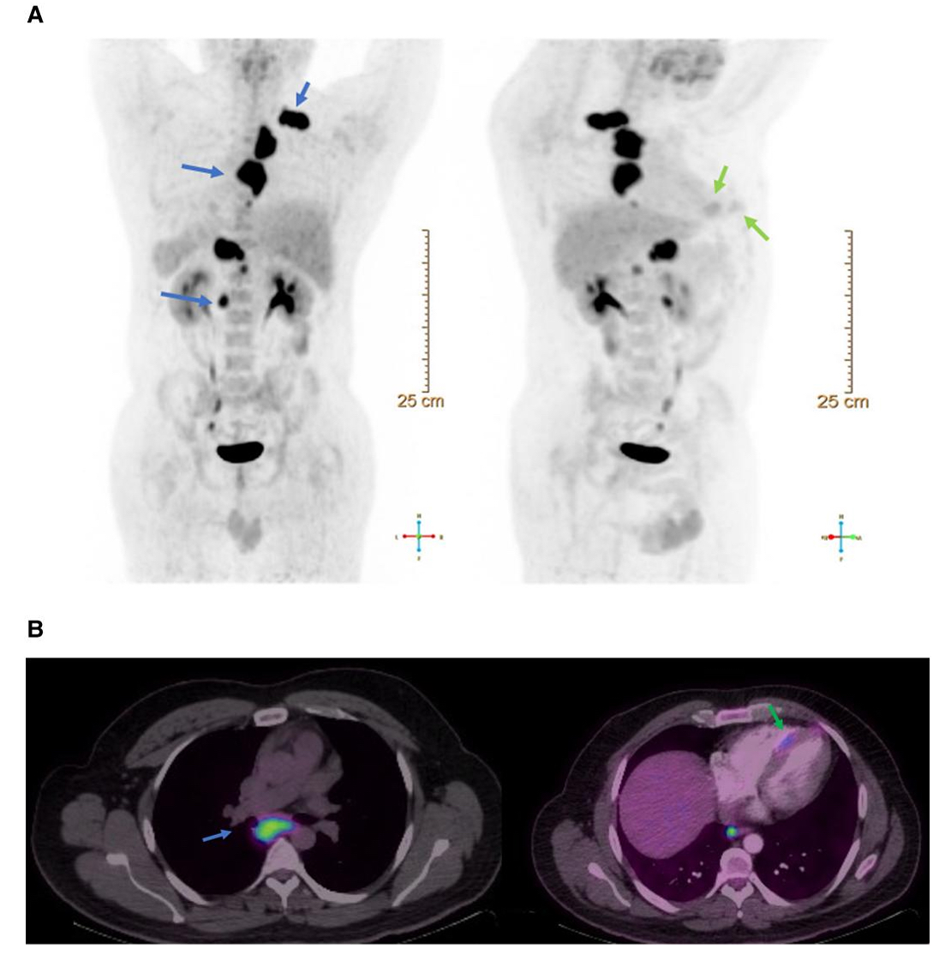
Supra and infra-diaphragmatic hypermetabolic adenopathy
FDG PET showed hypermetabolism in paratracheal and mid-septal regions

Slide 69
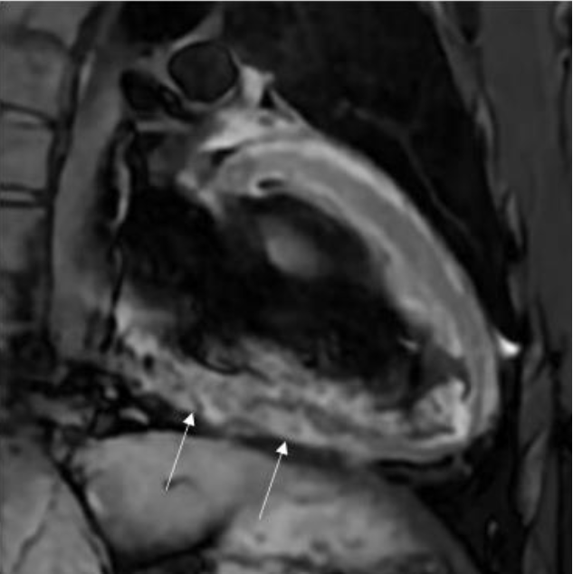
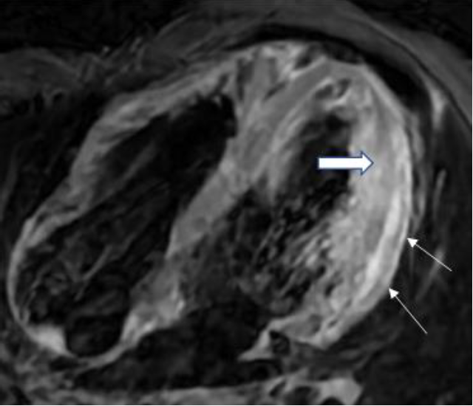
Patients with history of treated TB pericarditis, presented with VT. CMR reveals thickened pericardium with increased signals in the inferior and mid lateral wall respectively

Slide 70
Advanced radiological imaging
TTE has limited role in identifying localised effusions, pericardial thickness, and characterising the tissue
CMR allow real time analysis of heart motion and inflow patterns during normal breathing
Gadolinium based CMR helps in diagnosing myo-pericardial inflammation and monitoring the effect of therapy
Bright blood dynamic cine MR- intrapericardial contents
Cardiac CT- pericardial calcification and distinguish CCP and RCMP
18-FDG PET-early detection of disease, different stages of myocardial damage

Slide 71
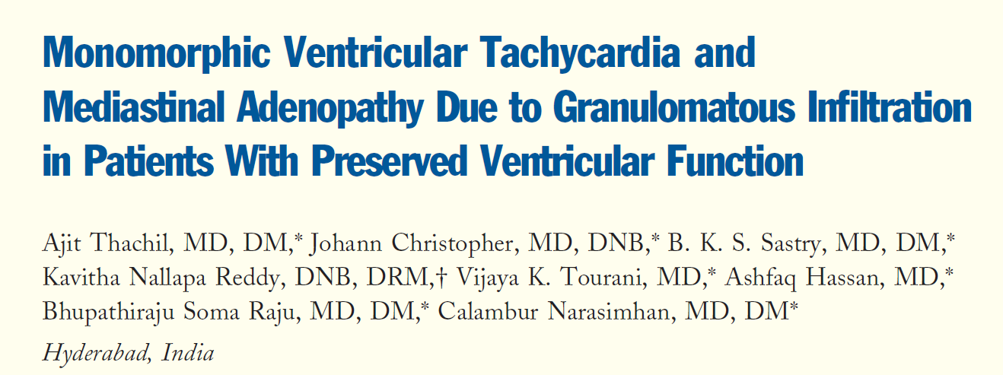
This report characterizes a syndrome of granulomatous infiltration presenting as sustained monomorphic ventricular tachycardia (SMVT) with mediastinal adenopathy in patients with preserved ventricular function

Slide 72
Study methodology
Inclusion criteria
Exclusion criteria
Sustained monomorphic VT
Mediastinal adenopathy
Preserved LV function
Coronary artery disease
Posterior fascicular VT
Channelopathies
Electrolyte disturbances

Slide 73
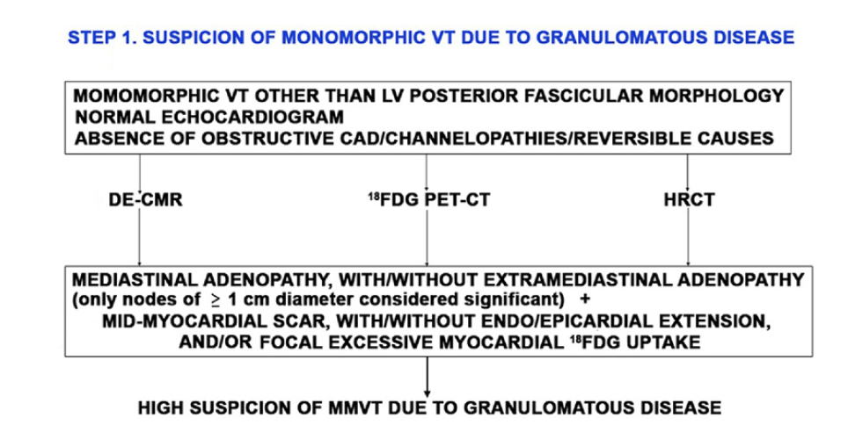
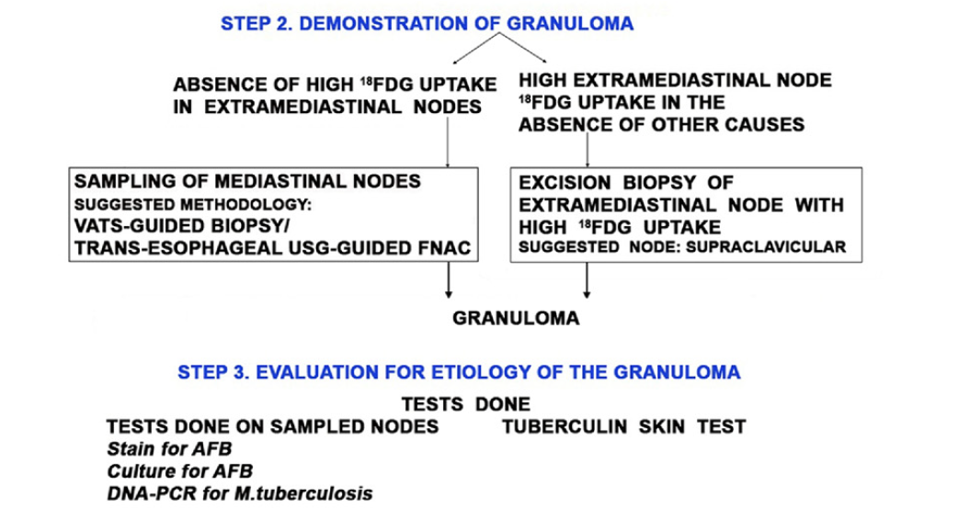

Slide 74
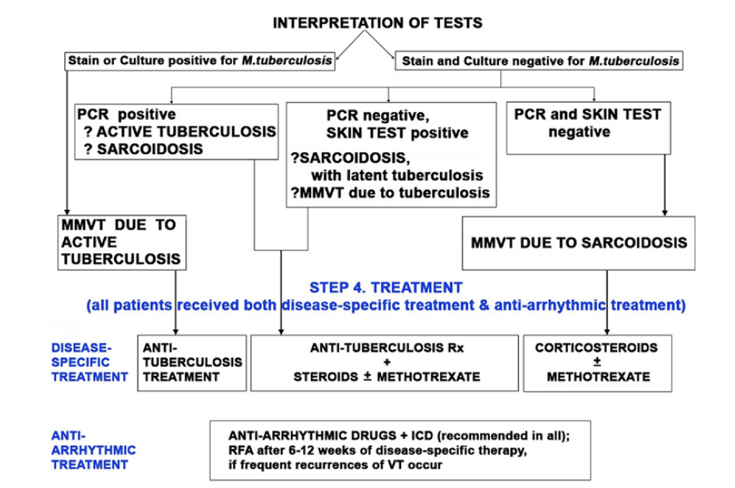

Slide 75
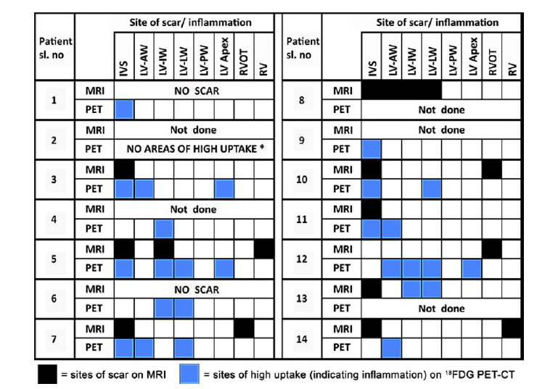
9 out of 11 patients had mid-myocardial scar on DE-CMR. PET-CT revealed inflammation in 11 out of 12 patients.

Slide 76
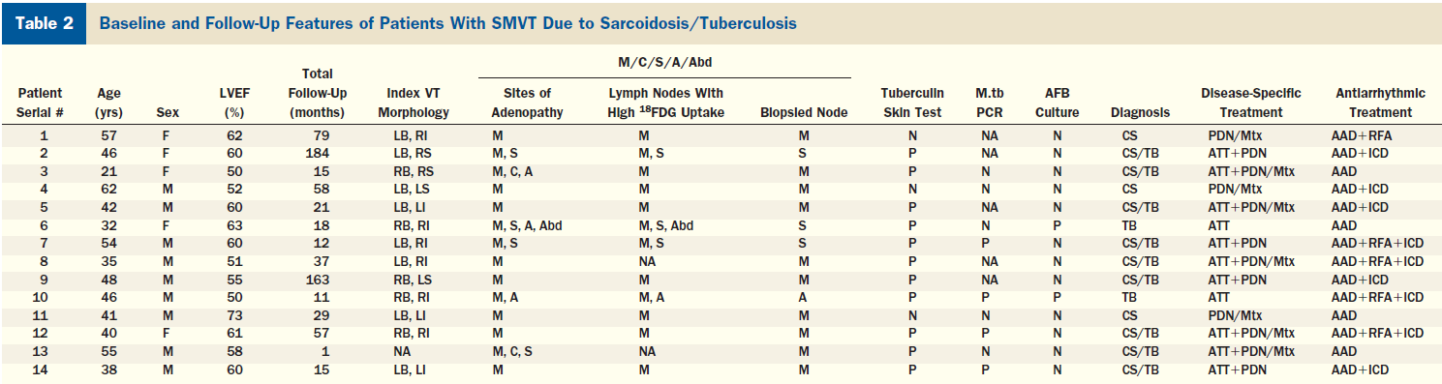

Slide 77
Results of the study
Evidence of tuberculosis was present in 79% of the cases
Whether M. tuberculosis PCR positivity in sarcoid granulomas has an etiological implication is a matter of debate
Tuberculin skin test positivity has been used to differentiate tuberculosis from sarcoidosis; whether this observation can be extended to isolated CS is unexplored
SMVT recurred despite initial treatment in 92%
Addition of disease-specific therapy abolished further recurrences in 64%
Decrease in SMVT correlated with resolution of myocardial inflammation on serial 18FDG PET-CTs.

Slide 78
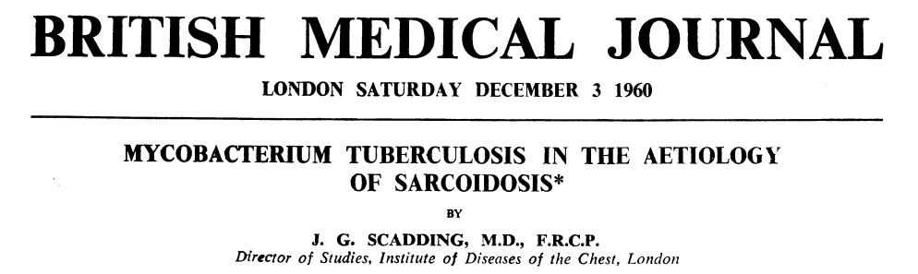
First description of TUBERCULO-SARCOID
Case series of 230 patients with sarcoidosis, tubercle bacilli were isolated at some stage in 29 patients(13%)
In 18 patients, tubercular bacilli was isolated during treatment for sarcoid
11 cases had TB preceding sarcoidosis
Change from a sarcoid to a caseating phase, with the appearance of tubercle bacilli in 5

Slide 79
Differential diagnosis
Infections | Metabolic | Foreign body | Drugs | Neoplasms | Unclear aetiology
Tuberculosis Atypical mycobacteria Brucella Whipple’s CMV, EBV Invasive fungus Hydatid cysts Toxoplasma | Farber’s Gout Hyperoxaluria CGD Cholesterol pericarditis | Cotton Suture material Valve prosthesis Vascular grafts and conduits | HAART Immune check-point inhibitors Beryllium TNF-alpha inhibitors INF | Lymphoma Solid organ tumours (melanoma and thyroid) | Sarcoidosis Wegener’s Churg-Strauss Giant cell myocarditis

Slide 80
Conclusion
Traid of lymphadenopathy, mid-myocardial scar or positive FDG-PET uptake in unexplained VT: Granulomatous myocarditis
LN biopsy is superior to EM biopsy
ALL THAT GLOWS IN PET IS NOT SARCOID
Steroids and immunosuppressants-inflammatory phase
RFA useful in scar phase
Life long follow up

